Slide 1
CUHKSZ-Overflow -an online forum database design
119010010 ChenBoyi 119010167 LiZihan
119010185 LinghuHan 119010108 HuangPengxiang

Slide 2

Contents
ER-diagram & Relational Schema & Normalization
1
2
3
Introduction
SQL Queries
4
5
6
Improve with Index
Web Demo
Data Mining

Slide 3
1. Introduction
A forum database designed for CUHKSZ programmers as a problem-solving tool

Slide 4
MAIN FUNCTION
Link the question to its correct answer
User
Login, Register, Upload profile…
Blog
Post, Like, Follow, Answer…

Slide 5
2. ER-diagram & Relational Schema & Normalization

Slide 6
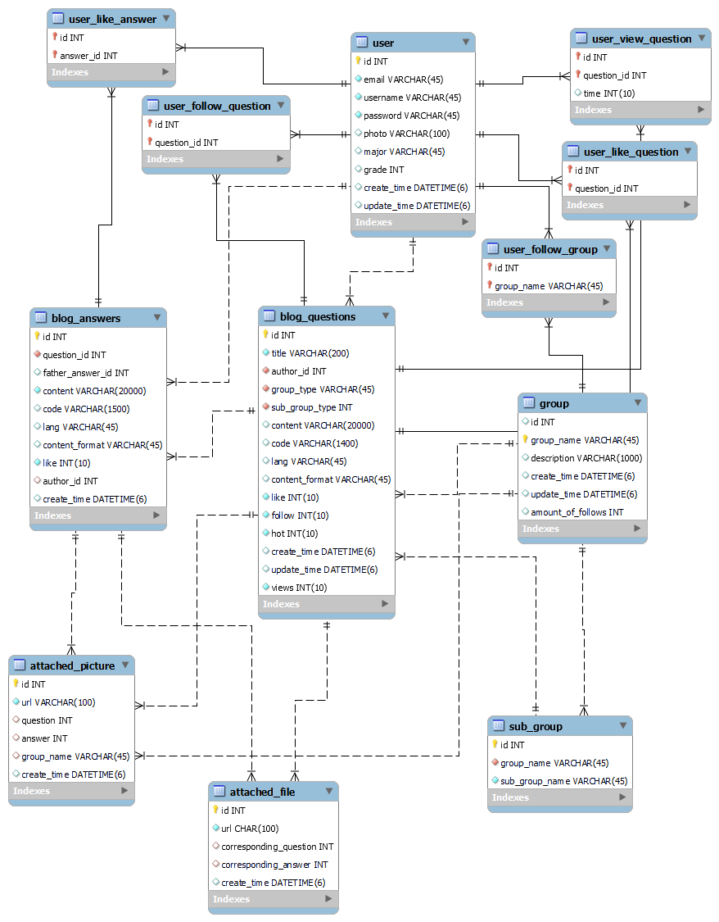
E-R diagram

Slide 7
Schema
user(id, email, username, password, photo, major, grade, create_time, update_time)
group(id, group_name, description, create_time, update_time, amount_of_follows)
sub_group(id, group_name, sub_group_name)
blog_questions(id, title, author_id, group_type, sub_group_type, content, code, lang, content_format, like, follow, hot, create_time, update_time, views)
blog_answers(id, question_id, father_answer_id, content, code, lang, content_format, like, author_id, create_time)
file(id, url, corresponding_question, corresponding_answer, create_time)
picture(id, url, question, answer, group_name, create_time)
…

Slide 8
Normalization
group(id, group_name, sub_group_name, description, create_time, update_time, amount_of_follows)
id | group_name | sub_group_name | description | create_time | update_time | amount_of_follows
1 | CSC3170 | {Assignment1, Assignment2, …} | Database System | 2022-04-30 | null | 100
group(id, group_name, description, create_time, update_time, amount_of_follows)
id | group_name | description | create_time | update_time | Amount_of_follows
1 | CSC3170 | Database System | 2020-04-30 | Null | 100
sub_group(id, group_name, sub_group_name)
id | group_name | sub_group_name
1 | CSC3170 | Assignment1
2 | CSC3170 | Assignment2
1NF

Slide 9
Normalization
Nonprime attributes are fully functionally
dependent on the primary key (id)
No nonprime attributes are transitively
dependent on the primary key (id)
Unique id
2NF & 3NF

Slide 10
3. Sample Queries

Slide 11
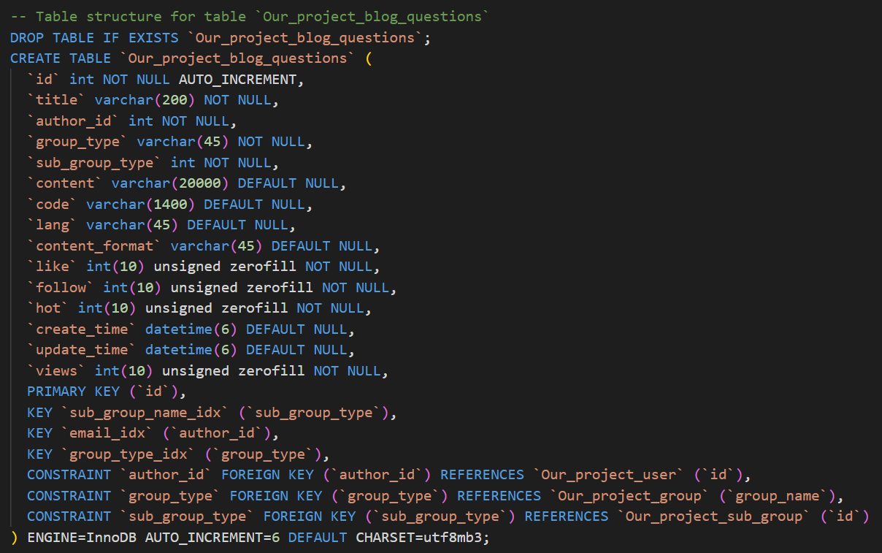
DDL: Definition with integrity constraints

Slide 12
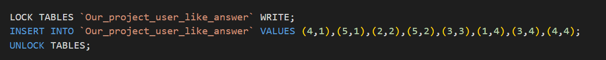
# Query 1: directly interacts with database

Slide 13
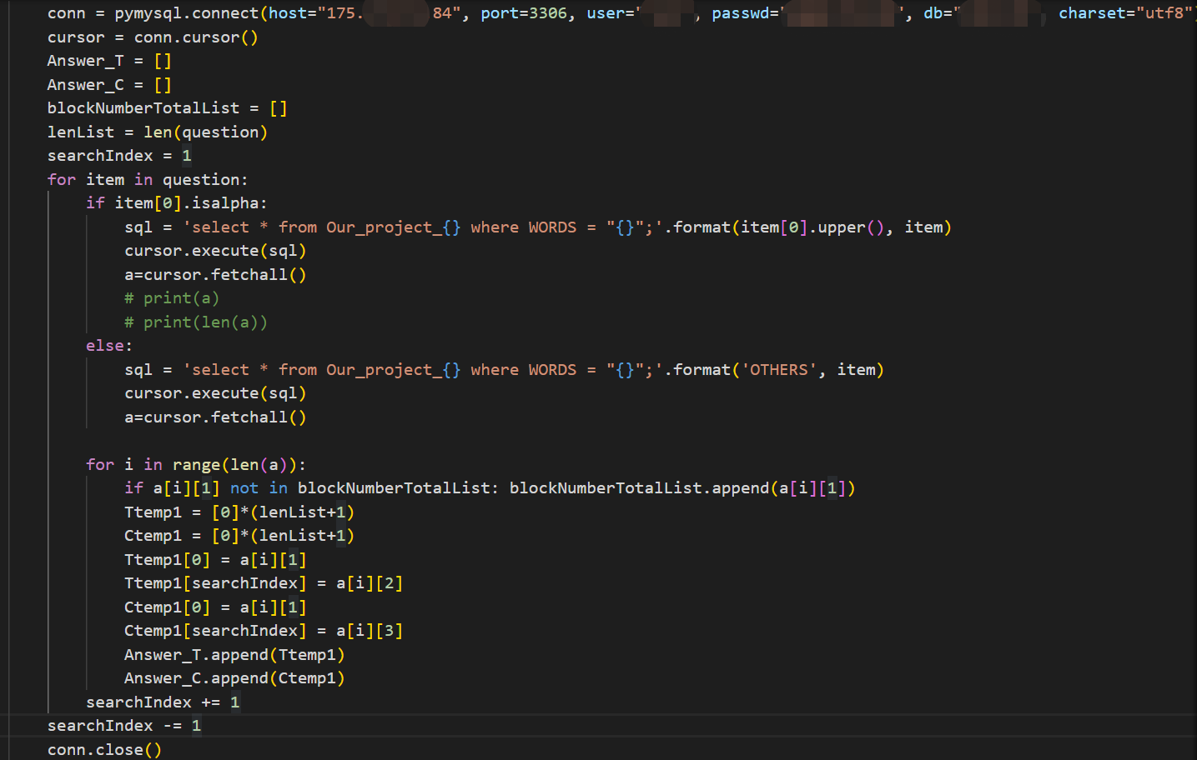
# Query 2: Query within python: SELECT

Slide 14
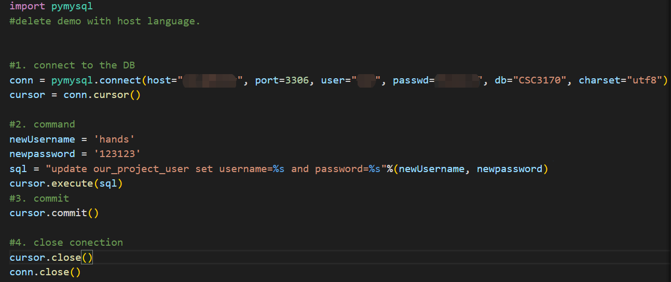
# Query 3: Query within python: UPDATE

Slide 15
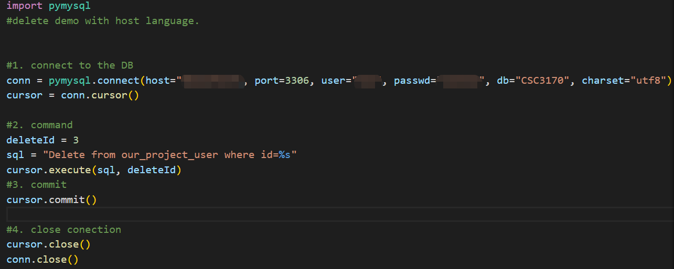
# Query 3: Query within python: DELETE

Slide 16
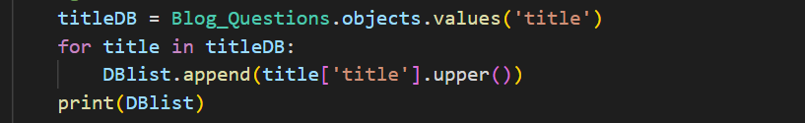
Other Ways
Alternative Method: Query set
It is less comprehensive than SQL, but still a way to interact with the database.

Slide 17
4. Improve with index

Slide 18
Hash Index
Advantage: faster when searching for a specific row (e.g. user id,)
Disadvantage: Use “memory” engine, volatile, not secure (are gone when dataset restart)

Slide 19
B-Tree Index
Advantage: can improve speed on searching for a range of values
sub_group_name
username
question_id
…

Slide 20
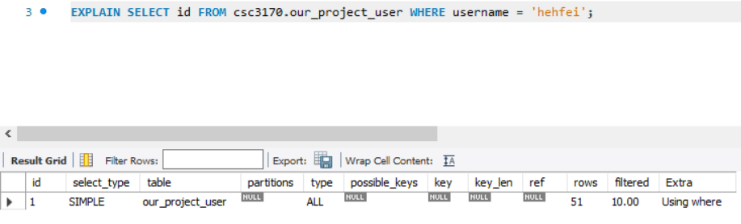
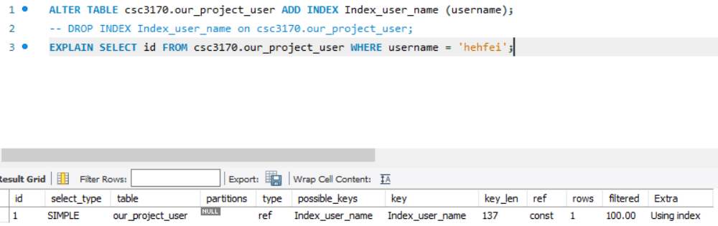
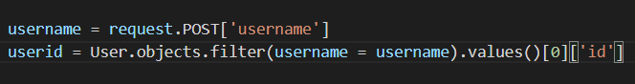
username
after
before

Slide 21
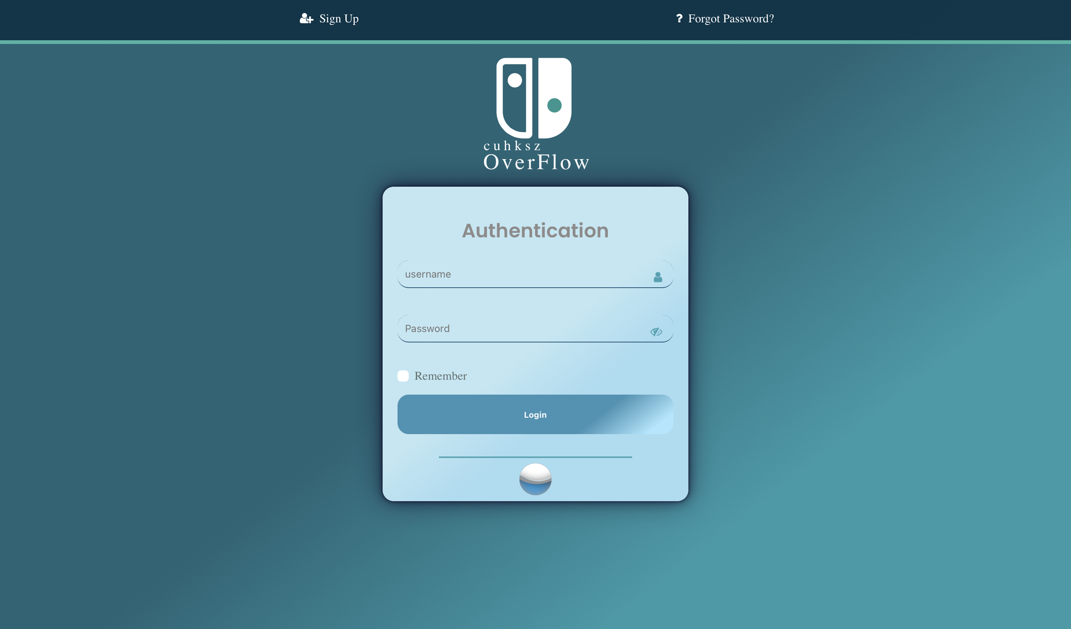
5. Web Demo
http://www.cuhksz-stackoverflow.cn/

Slide 22
6. Data Mining

Slide 23
Searching Process
Sort the blogs based on similarity
Filter questions
into serval key words
Search the keywords in inverted index table

Slide 24
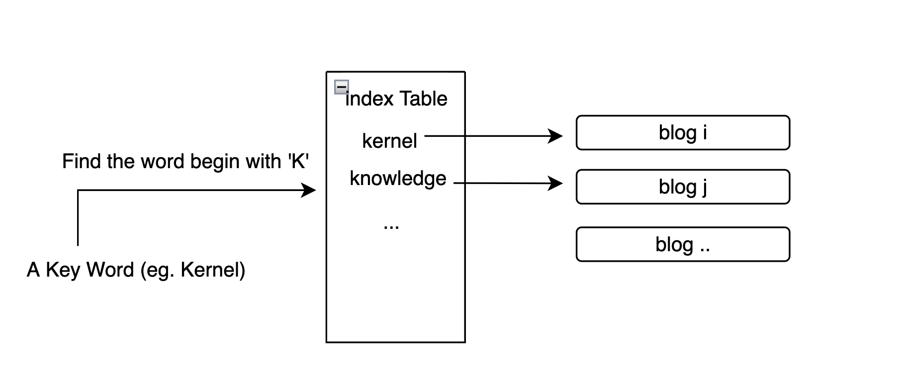
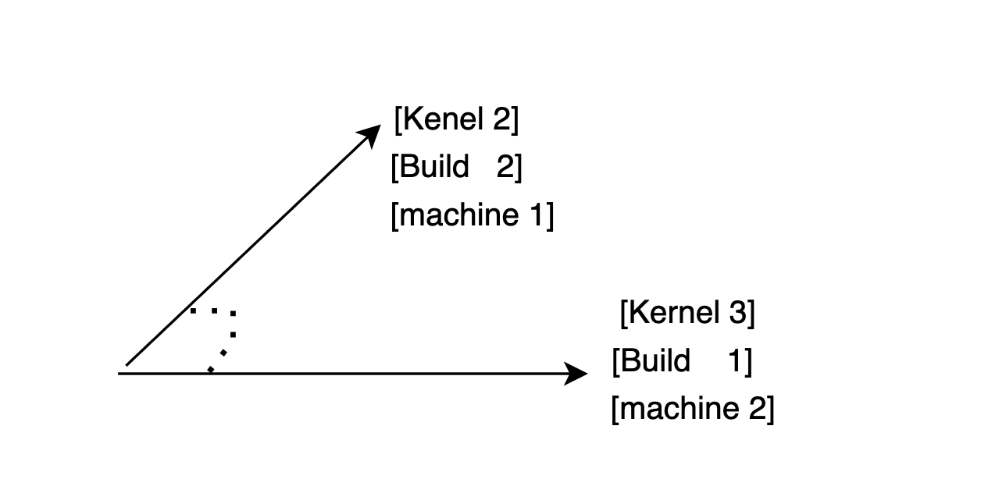
Search Engine
Key word tokenized: Natural Language processing (filter the stop word, tense identify, upper letter )
Searching Speed: inverted index table
Similarity Comparision: TF-IDF, key word vector projection

Slide 25
Thanks!
If you have any questions, feel free to raise up!

